Slide 1
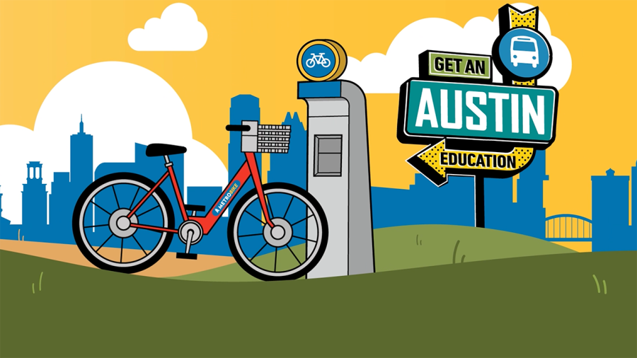

Analysis of the bike-stations and trips within Austin
Presented by: Dinara Akmurzina, Marina Zviagina, Magdalena Krupa,
Sharyn McPherson, Vanessa Chan, Lamiaa Bahgat

Slide 2

Plan
Introduction
Roadmap
Process
Key Findings
Recommendations
Conclusion

Slide 3
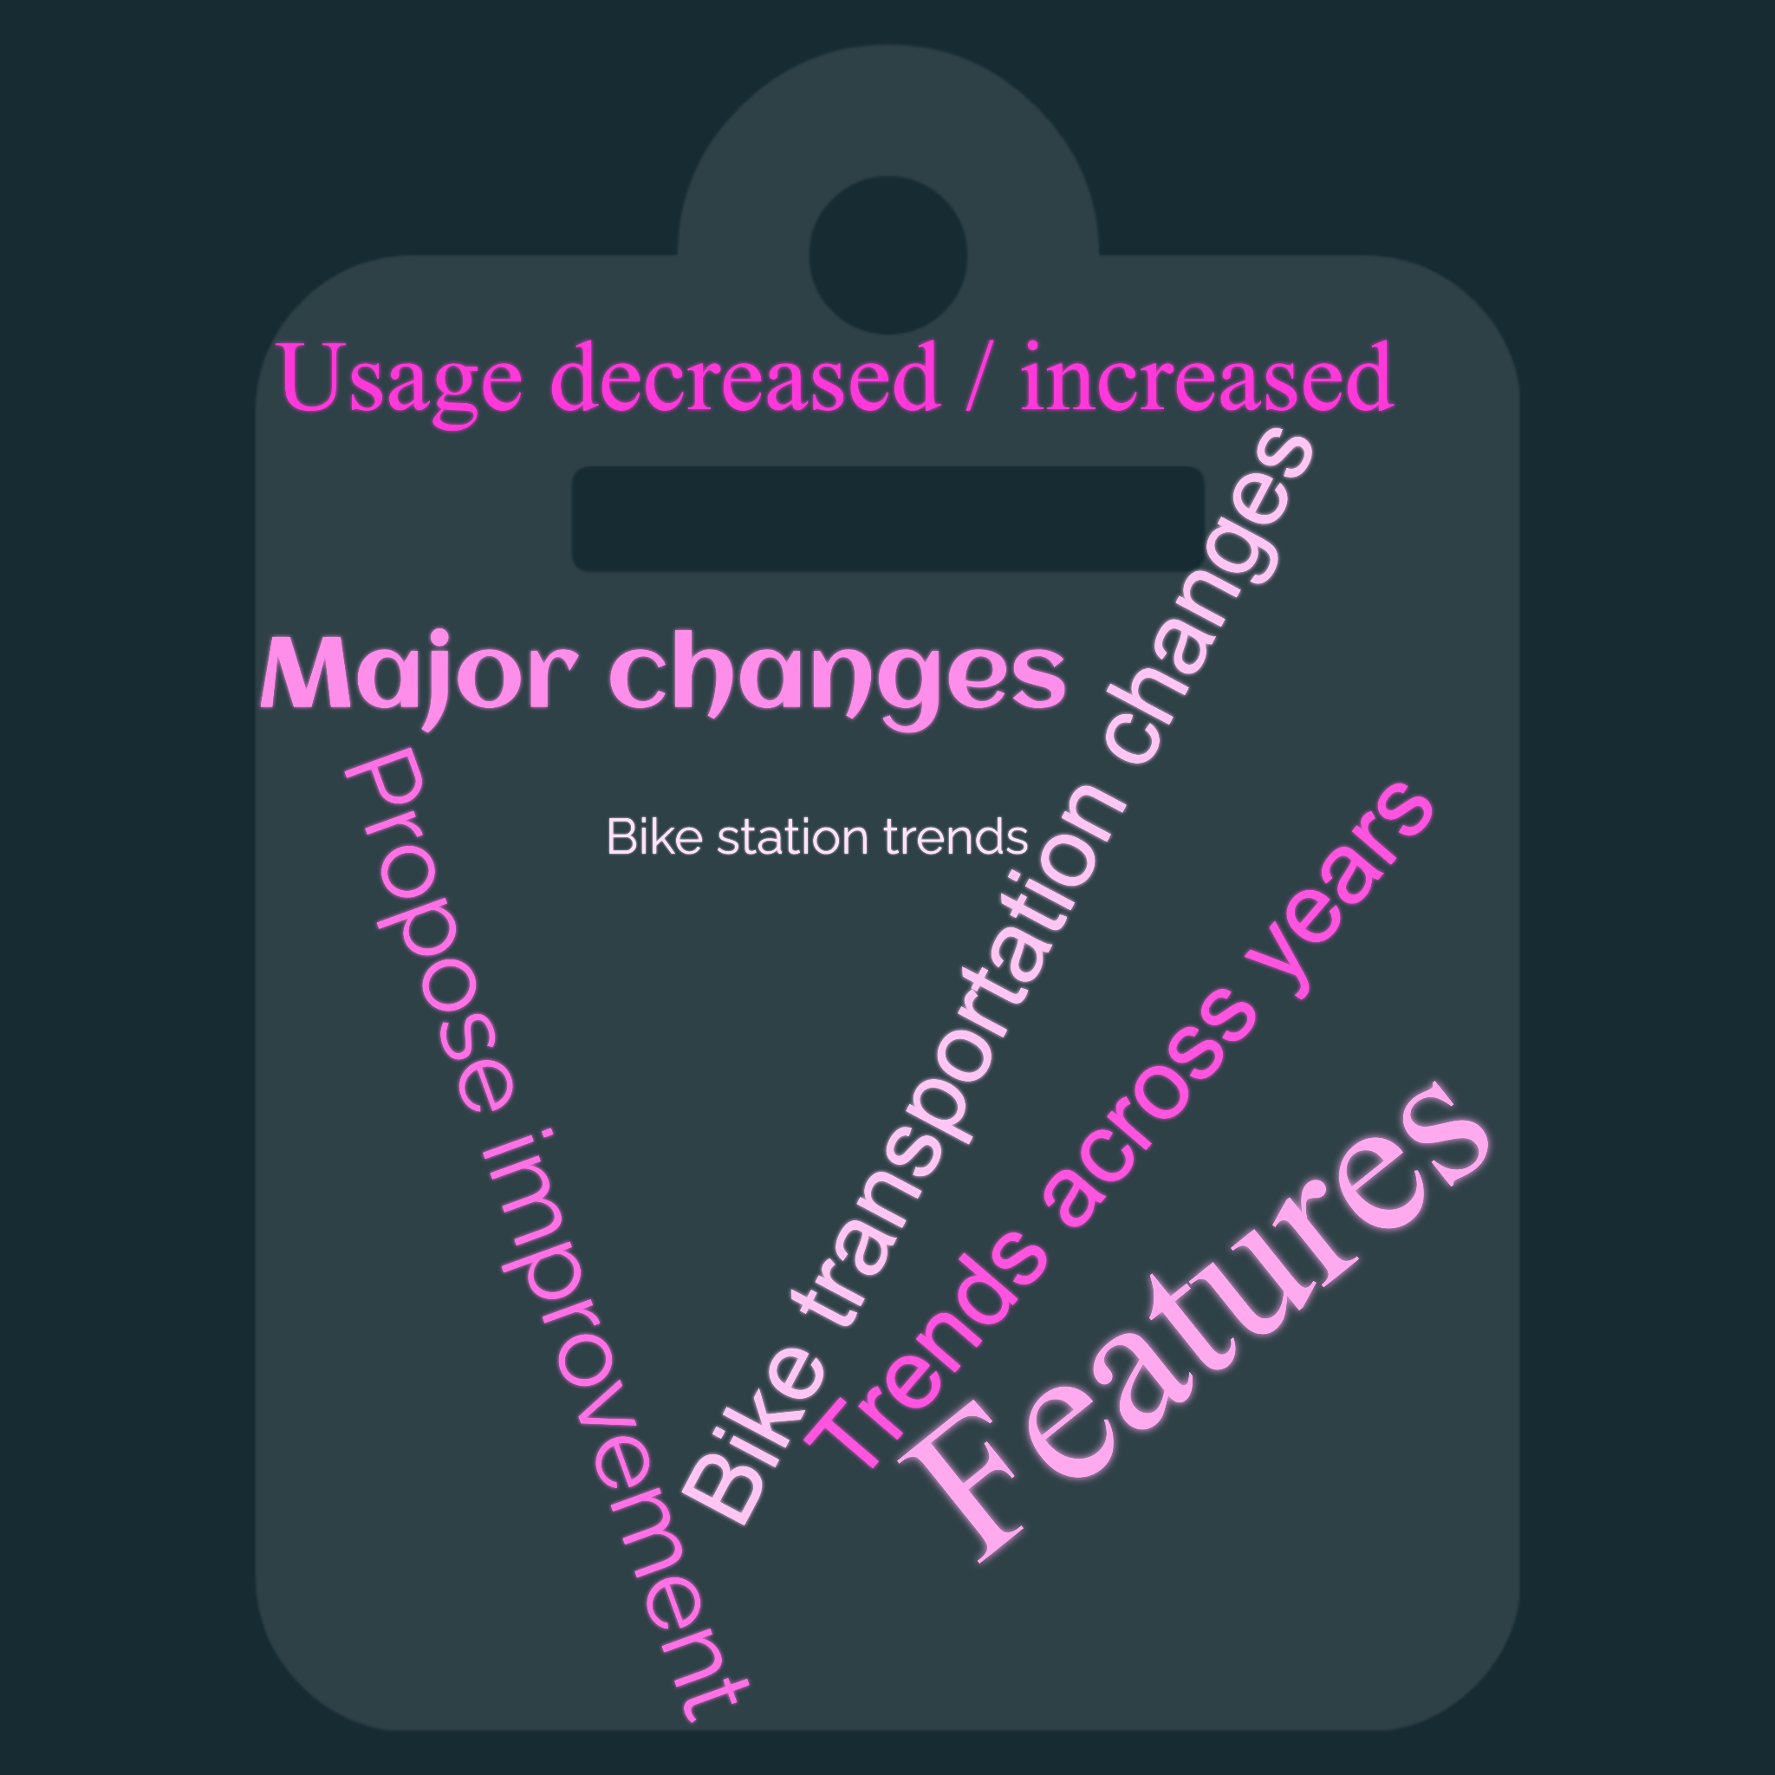
Question:
How has bike transportation changed during the investigated period of time and how can it be improved?
Key Findings:
Bike Usage Frequency Analysis
Weather Analysis
Bike Station Activity Analysis
Notes:
sub-questions/aims

Slide 4
Introduction
Aims:
Investigate how bike transportation changed between 2014 and 2022 in Austin, Texas
Suggest the ways to improve bike transportation in Austin, Texas
Objectives:
Study bike station trends in the examined period of time
Analyse changes in bike usage in the examined period of time
Explore factors that contribute to an increase in bike trips and subscriptions
Propose improvements for bike transportation

Slide 5
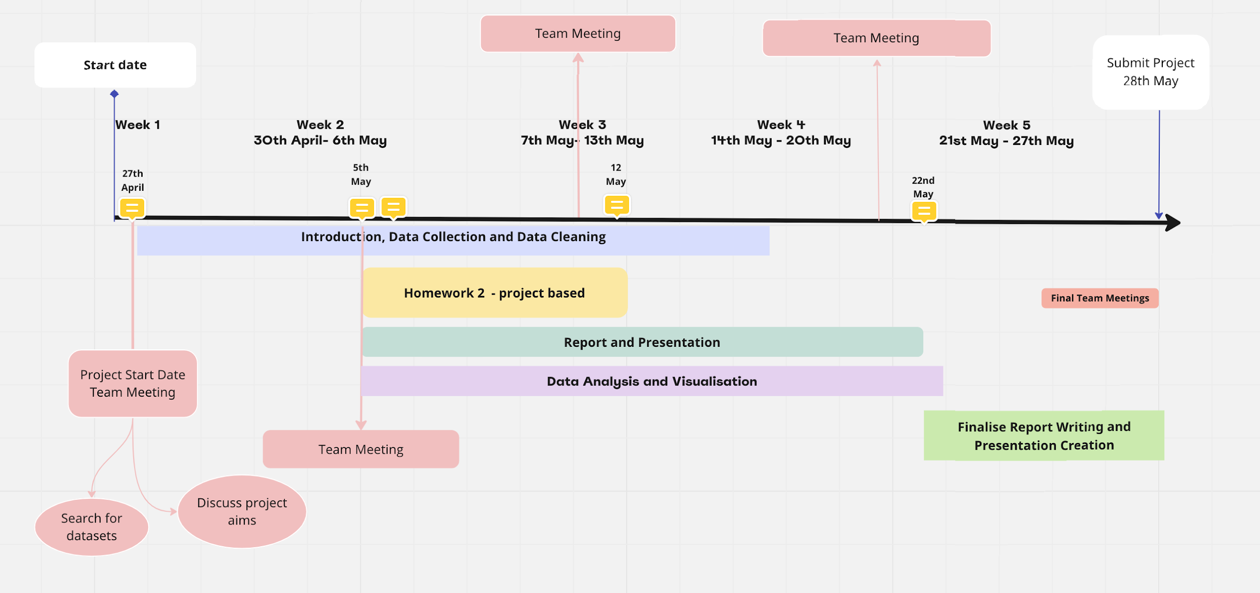
Roadmap

Slide 6
Process
Data sets:
Google Cloud BigQuery:
Bike Trip Data
Bike Station Data
Visual Crossing:
Weather Database
Steps:
Data cleaning
Data exploratpory
Data analysis
Data visualisation
Libraries and packages:
Communication tools:
Pandas
Seaborn
Matplotlib
ArcGIS
Folium
ScalarMappable
calendar
Datetime
Chat and messaging on Slack
Google Colab
GitHub
Trello

Slide 7
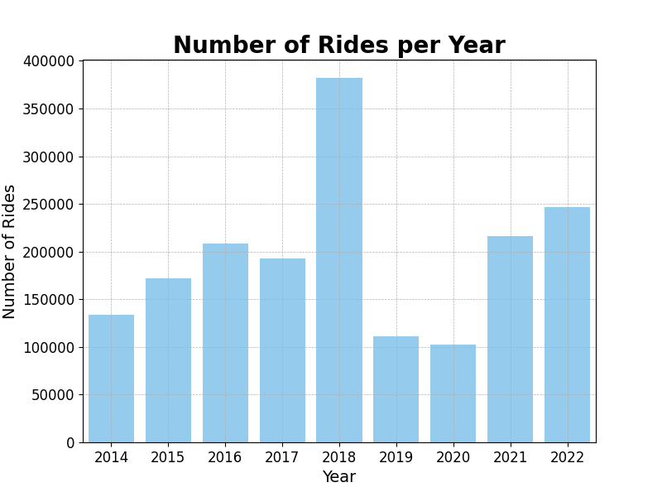
Bike Usage Frequency Analysis:
Trends
Overall increase in bike rides from 2014 to 2022
Most Popular Year 2018
Least Popular Year: 2020
Reasons
Growing population in Austin
In 2018, University of Texas partnered with Metrobike to offer free student membership
In 2020, Austin enters lockdown due to COVID-19

Slide 8
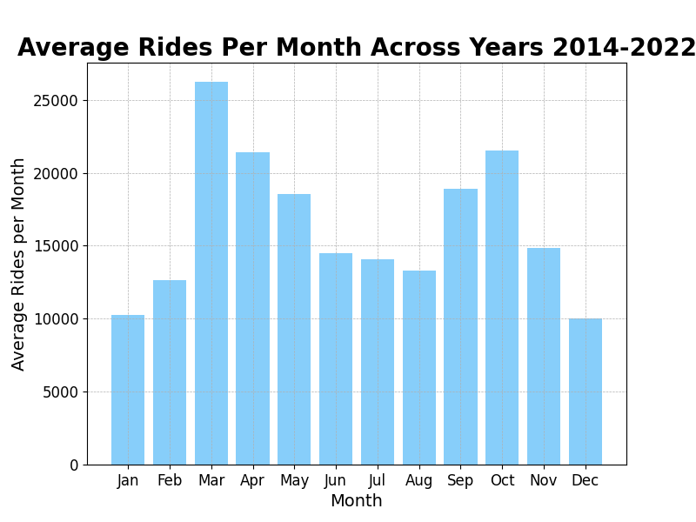
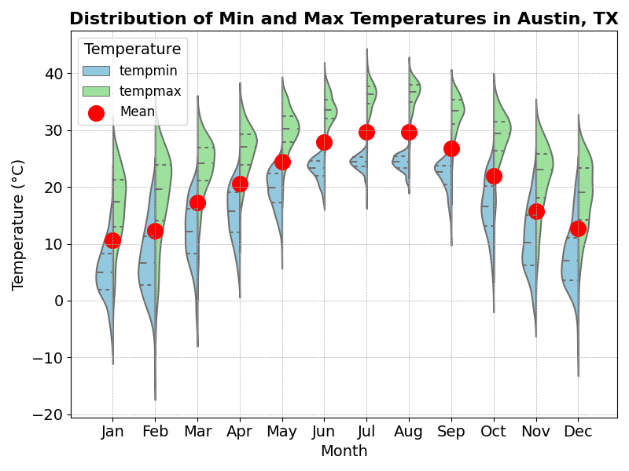
Weather Analysis
Trends
Most popular month: March
Correlation between temperature and ridership:
→ Decrease in rides during hotter and colder months, i.e summer and winter seasons
Optimum temperature for bike riding: 19℃

Slide 9
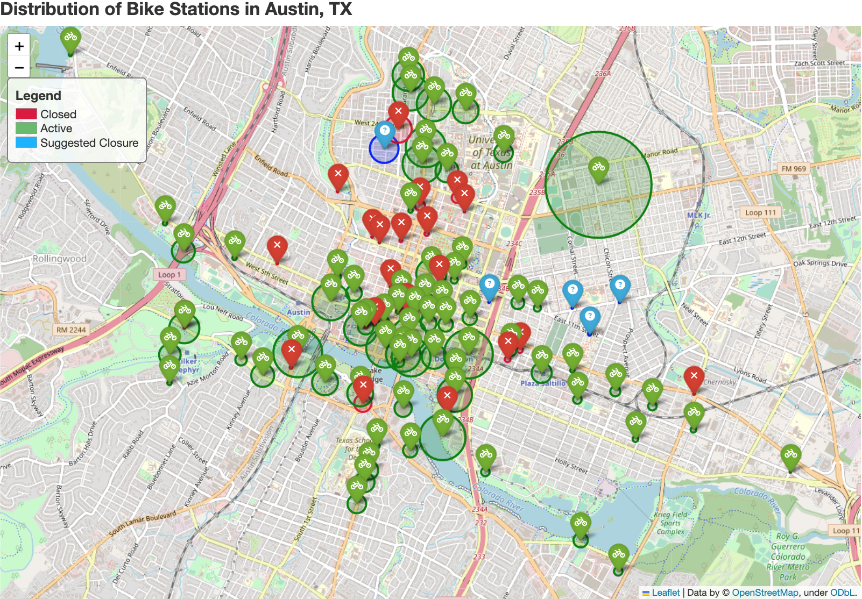
Bike Station Activity:
University of Texas
Bike Station Closures in Uptown/ North District
Downtown District
Notes:
Bike Station Closures in Uptown/ North District
mostly occupied by government organisations, law firms, NGOs, regulatory offices and parking garages
Low usage for work commutes
Most popular stations are on campus and in downtown area

Slide 10

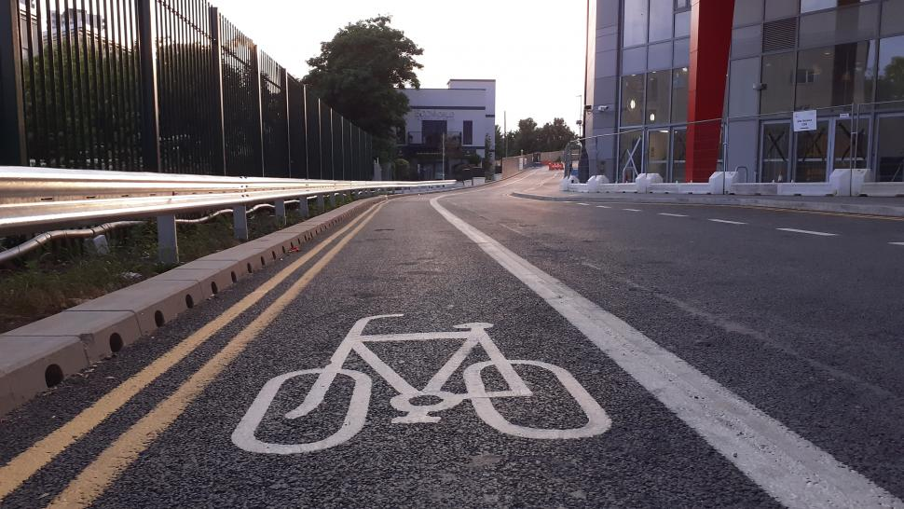
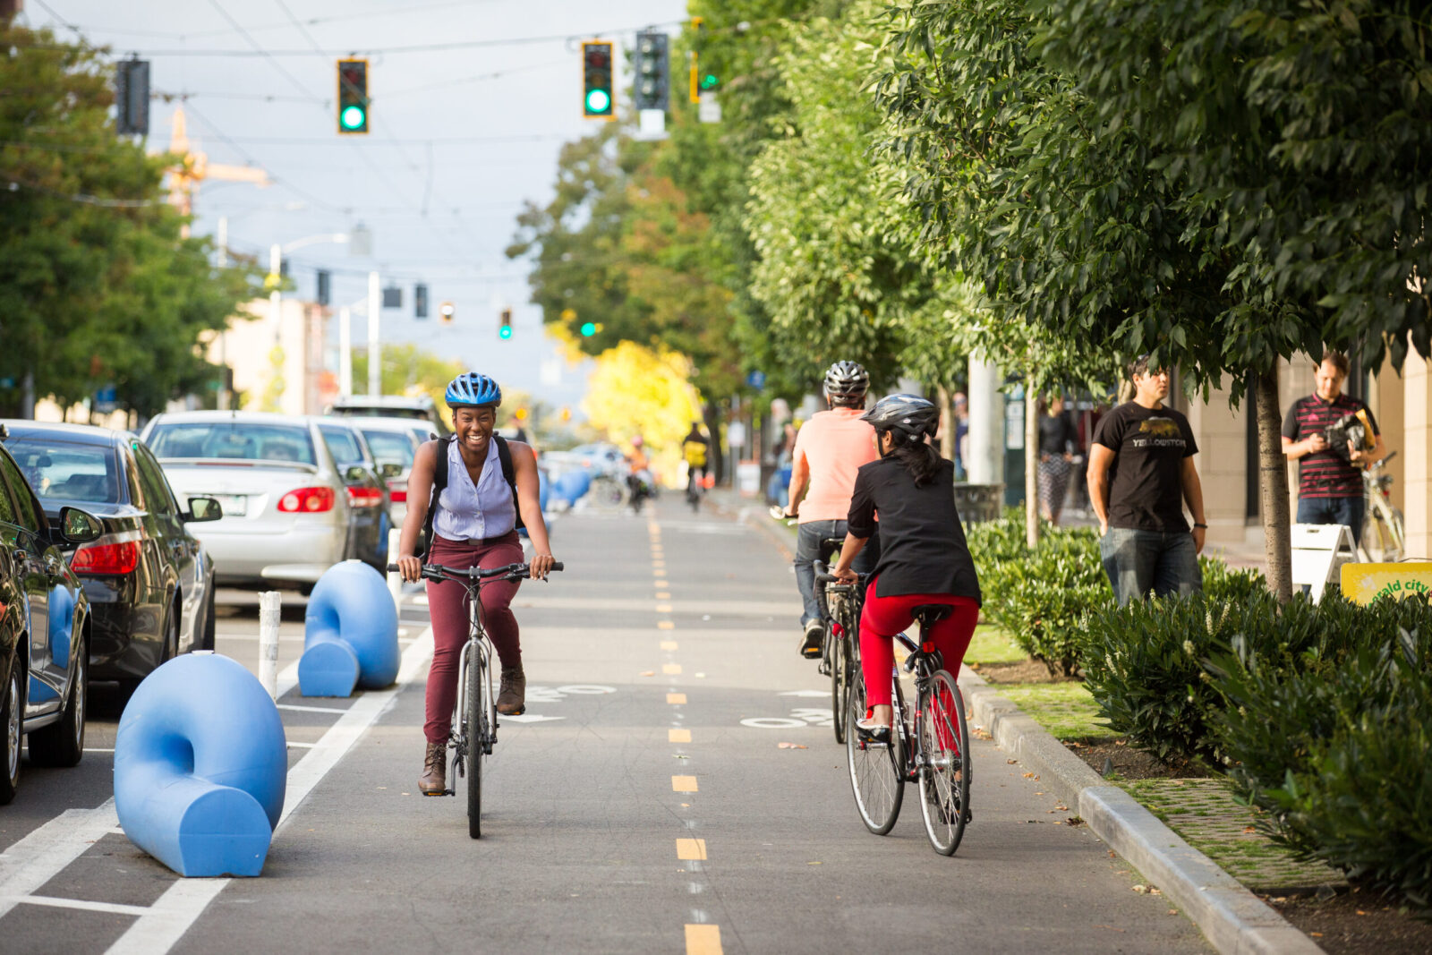
Recommendations
Special promotions for off-peak seasons
Subsidised subscription plans for companies
Reevaluate less popular bike stations to reallocate funding
Enhance bike accessibility eg. bike lanes, storage facilities etc
More public level initiatives eg. Bike to Work Day
Notes:
Dont need to go through all the recommendations

Slide 11
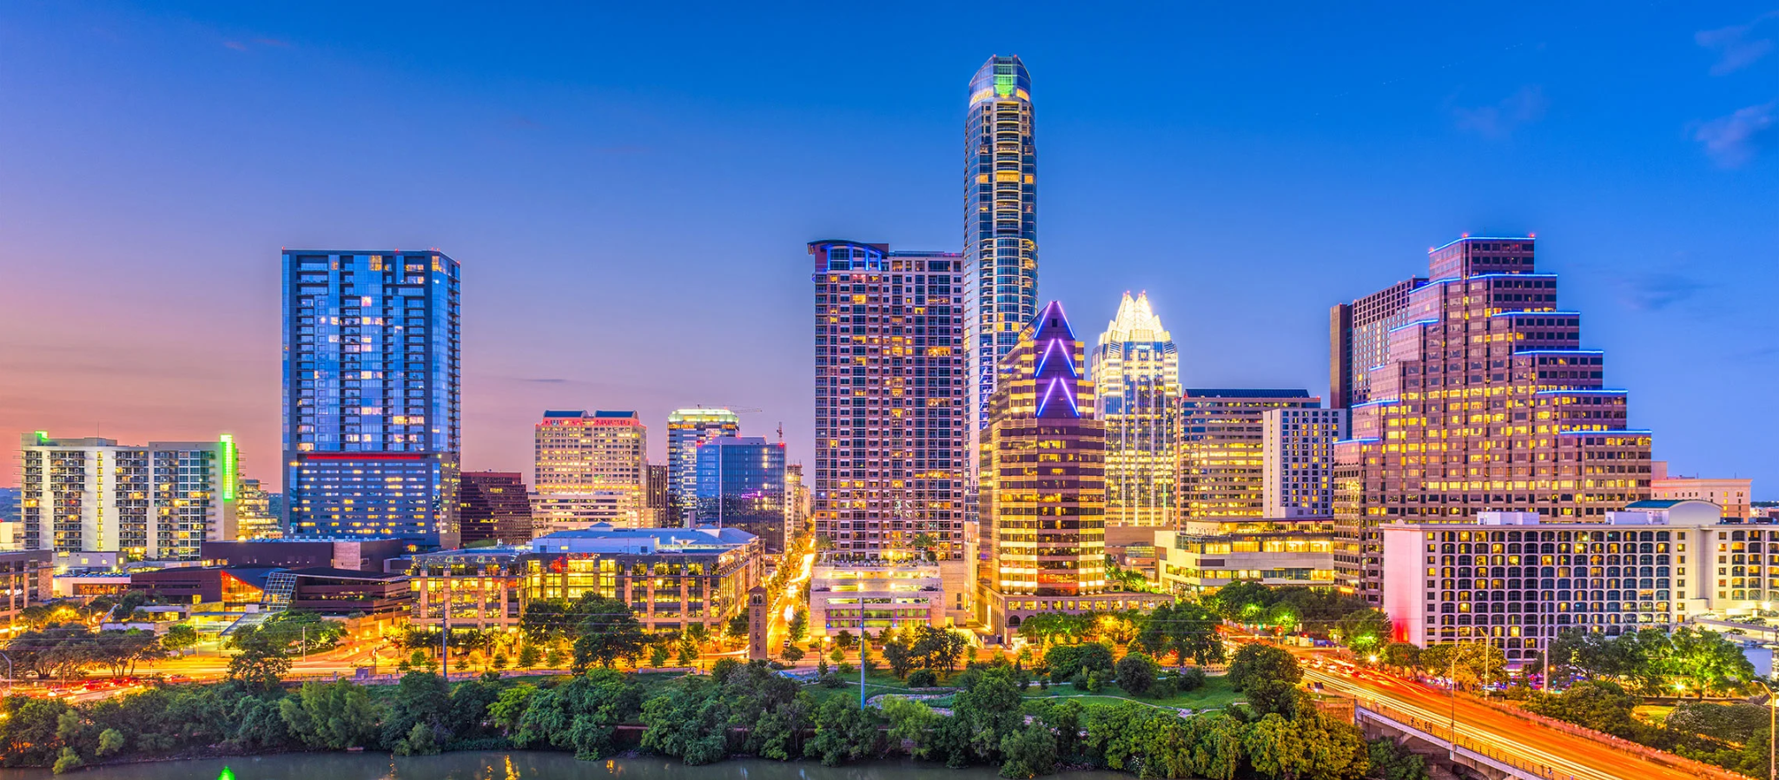
Conclusion:
Identified trends and patterns in bike usage
Identified factors that impact bike usage
Give recommendations on ridership can be improved

Slide 12



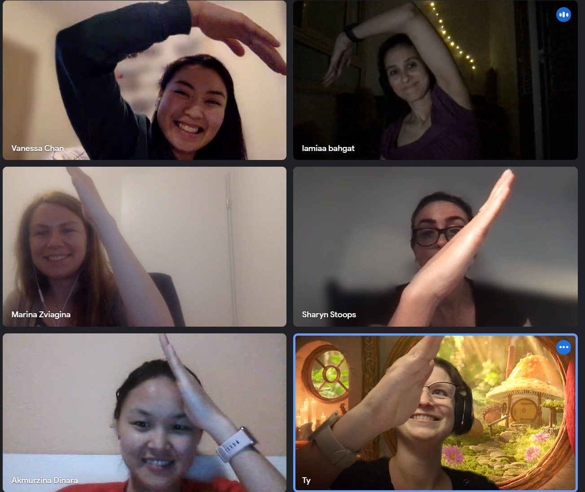
Thank you!
Sponsors
CFG students Data1
Andreea
Georgia
Our Project Group:
Lamiaa Bahgat
Sharyn McPherson
Magdalena Krupa
Vanessa Chan
Marina Zviagina
Dinara Akmurzina

